Slide 1

Sales Risk Mitigation
A Three-year data analysis to protect store Profitability
Data Analytics PILOT Team
September 2013

Slide 2
Executive Summary
Program Scope:
Evaluation of three years of weekly sales for 45 stores
Limited attributes for focused analysis
Pilot data science team utilized for unbiased evaluation using validated data science techniques
Resulting code once approved to be submitted to InnerHub
Bottom Line Up Front:
Average yearly temps do not correlate with average yearly store sales, nor do weekly sales correlate strongly with temperature
Dept Sales performance not correlated with Temp
Impacts of current independent variables on Weekly Sales low; model confirmed reliable
Phase 2 considerations to be discussed
Megan, Zane

Slide 3
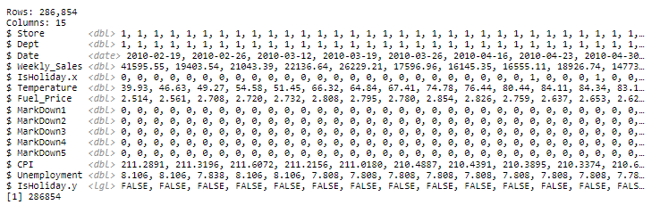
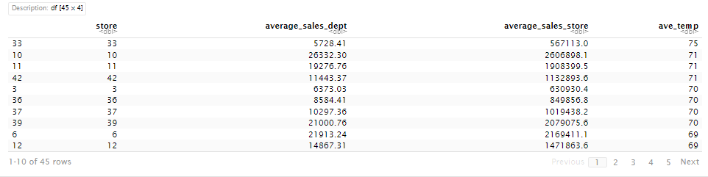
Data Inputs
Joined CSV files after date transformation
Excel File with Store Averages
Megan, Zane

Slide 4
Project Inquiry
Section 1: complete the effect on weather and how it affects the sales of 45 different stores.
Summary data - top 5 max hot and cold, top 5 min hot and cold, and Average weekly sales data per store
Time series scatter plot or line graph
Conclusion business question - which stores should be more active with sales plans to be profitable in different temperatures?
Section 2: complete how the weather affects the 99 departments and when which department becomes more profitable
Summary information - average sales per department
Top 5 performers in the hot and the cold
Worst 5 Performers in the hot and the cold
Conclusion business question - which departments should have deals or be moved to different locations to improve overall store sales weekly?
Section 3: compare the effect of CPI, unemployment, and Fuel price, and temperature on weekly sales to determine if good predictors and if there might be another metric that should be considered instead of just temperature.
Multi-variable regression - includes CPI, unemployment, and Fuel price
R Squared value -
Correlation Matrix -
Conclusion- What indicators Drive Sales? What business decisions can we make? Why did we make those decisions?
Zane, Nick, Megan

Slide 5
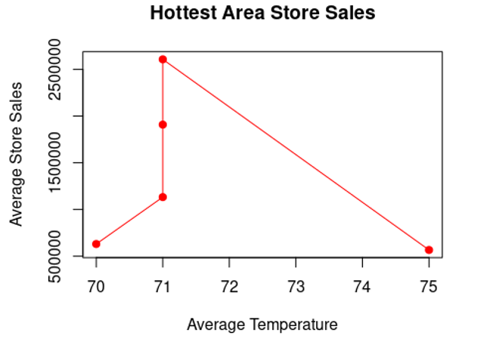
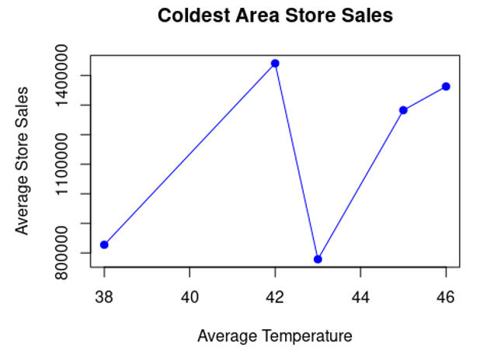
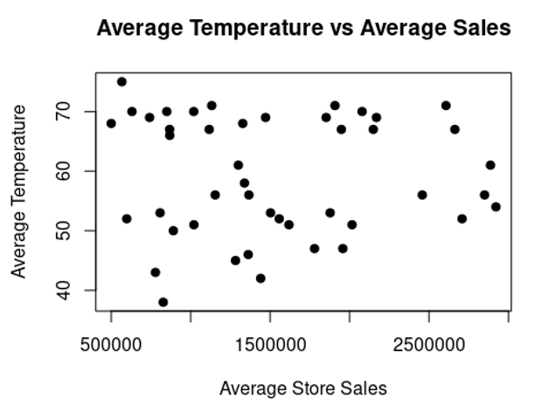
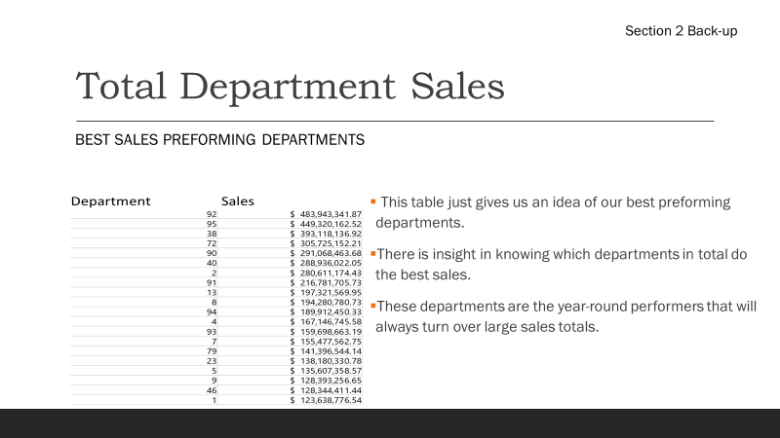
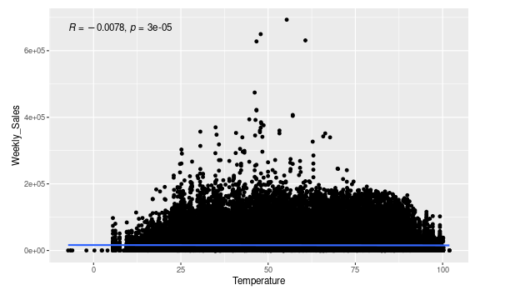
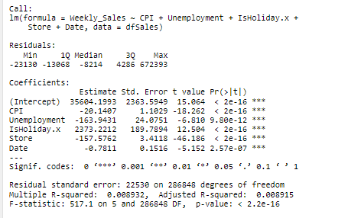
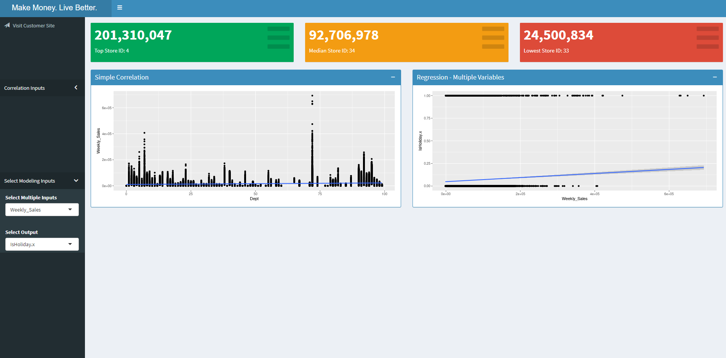
Data Outputs & Insights
1
2
Total Dept Sales
3
Correlations
MVR Output
Shiny Dashboard
Average yearly temps and sales do not correlate, nor do weekly sales with temp
Lowest performing Dept over time is #60 and highest performing Dept over time is #92 in both hot and cold weather
Predictor variables of Weekly Sales significant but don’t explain the sales model
Zane, Nick, Megan

Slide 6
Next Steps
Finalize code to share to Walmart’s InnerHub
Approve funding for Phase 2: $9M, Payback 0.1 years
Geographic data, extreme weather, online orders, and marketing campaign to be integrated into Phase 2 analysis
Also consider data transformations and other modeling techniques in Phase 2
Dashboard to be dynamic in Phase 2 to allow for dynamic multivariate analysis and real-time data
Megan, Nick

Slide 7
Q&A
2 minutes - Additional to be accepted via email to Analytics Team
Nick

Slide 8
Back-up

Slide 9
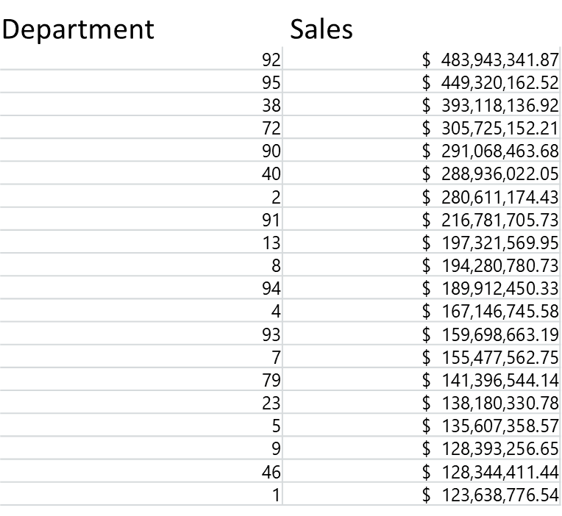
Total Department Sales
Section 2 Back-up
Best sales preforming departments
This table just gives us an idea of our best preforming departments.
There is insight in knowing which departments in total do the best sales.
These departments are the year-round performers that will always turn over large sales totals.

Slide 10
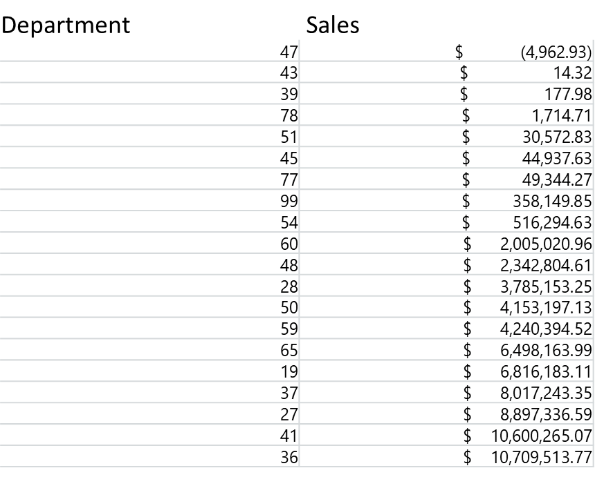
Total Department Sales cont.
Section 2 Back-up
Worst sales preforming departments
Part of this data in this table can be misleading.
A couple of the departments don’t have the long-term data necessary to know if the department will be profitable.
It would be smart to consider the least prosperous departments around the 2 million mark.
As those are the departments that have full data sets that can be reviewed.

Slide 11
Best Performer in Warm Weather
Section 2 Back-up
Department | Sales
92 | $ 328,716,425.80
95 | $ 319,541,152.04
38 | $ 268,410,946.64
90 | $ 199,073,306.11
40 | $ 197,262,558.11
2 | $ 195,030,853.05
72 | $ 194,933,288.35
91 | $ 148,897,484.18
13 | $ 138,041,338.31
94 | $ 134,882,518.92
8 | $ 133,251,779.70
4 | $ 116,243,929.82
93 | $ 110,993,341.51
9 | $ 98,390,070.41
7 | $ 97,754,749.84
79 | $ 97,207,288.98
23 | $ 94,134,551.40
46 | $ 87,958,596.72
10 | $ 82,754,499.65
These departments are the most profitable when the weather is above 60 degrees.
During the late spring and summer months the business can has a couple options we can use to boost sales.
We can make the shelf spaces for these products bigger to entice more sales.
We can offer similar products to give our customers more variety.
We can move the products in the store to areas that allow the customer to travel further into the store.
We can offer coupons or deals to get customers into the store to buy the most in demand products.

Slide 12
Best performer in Cold Weather
Section 2 Back-up
Department | Sales
92 | $ 155,226,916.07
95 | $ 129,779,010.48
38 | $ 124,707,190.28
72 | $ 110,791,863.86
90 | $ 91,995,157.57
40 | $ 91,673,463.94
2 | $ 85,580,321.38
91 | $ 67,884,221.55
8 | $ 61,029,001.03
13 | $ 59,280,231.64
7 | $ 57,722,812.91
94 | $ 55,029,931.41
5 | $ 53,634,766.92
4 | $ 50,902,815.76
93 | $ 48,705,321.68
79 | $ 44,189,255.16
23 | $ 44,045,779.38
1 | $ 43,684,906.16
46 | $ 40,385,814.72
10 | $ 35,142,887.93
82 | $ 34,852,975.87
14 | $ 33,602,293.27
9 | $ 30,003,186.24
Something important to note with this data breakdown is that departments 92, 95, and 38 are still the top producers in sales for the store.
This means that products from those departments aren’t seasonal and infact produce sales year-round.
This also would indicate that a lot of Walmart's departments are good producers year-round.
The departments that are affected more by temperature are going to be found toward the middle in terms of sales producing
This gives us the insight that the departments with the better sales numbers aren’t affected by temperature.

Slide 13
Sales Strategies to Mitigate Weather Risks
To Do
Doing
Validating
Done
Maps in R
Brainstorm training model
Descriptive stats in R
Brainstorm topics
Share dataset
8/15/22
Define problem
Kanban board
Shared project in R
Rmd created, CSVs read in
Project plan – theme & topics
8/29/22
Experiment & munge data
Date transformations
Weather on Sales (part 1)
Total Sales By Dept (part 2)
Weekly Sales & Shiny (part 3)
9/19/22
Final report & code sheet
8/15/22 status & issues: 1. compressed timeline given competing priorities will be biggest obstacle, 2. do not have clear path to sharing R project / code; 3. one team member likely won’t have connectivity for 8/15 project update
8/29/22 status & issues: Wrangling date formats has been a challenge; bottleneck for further munging and data exploration; we switched to a simpler one-file dataset on Kaggle due to date conversion bottleneck; also we would need to know how to handle loops to sum dept data and pass store total back over to other CSV file for each week; maps may not be possible because we don’t have locations or coordinates
9/12/22 status & issues: Believe we fixed the data issue, part 2 in validation; part 3 issue with low adjusted R Squared; maps not be possible because we don’t have locations or coordinates; may add Shiny
Recommendations for Phase 2: Collaborate in another platform, upgrade dashboard to model dynamic inputs by user (multivariate regression on multiple independent variables)
Group A: Megan, Nick, Zane

Slide 14
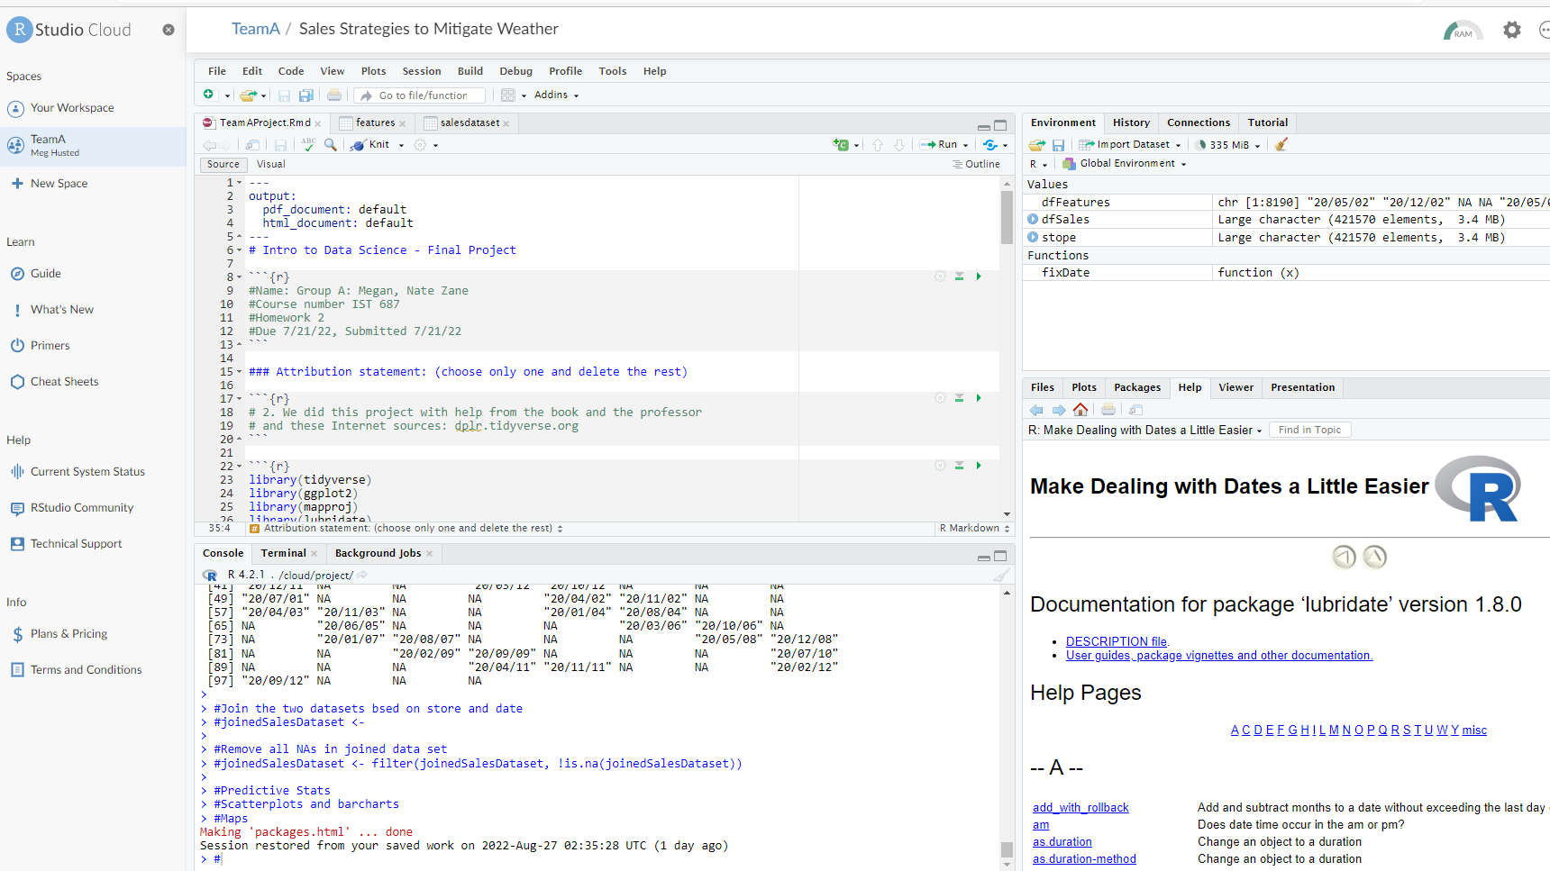
4 Quadrant Status
Accomplished
Worked well
Shared R project
Overall theme
Specific problems to solve
Great plan
Executed on schedule
Good R foundation from class
Plans
Issues
Consider other datasets on Kaggle
Extend the dashboard
Findings significant but very low R square in MVR
Don’t have location or geographic coordinates to create maps
Sharing project for collaboration – R Studio Cloud was not intuitive and limited RAM
Date strings were difficult to fix
Group A: Megan, Nick, Zane

Slide 15
Sources
Background:
How Wal-Mart enables ‘innersource’ with Github (cio.com)
Code:
https://stackoverflow.com/questions/65596464/parsing-dates-with-different-formats-using-lubridate
https://shiny.rstudio.com/articles/layout-guide.html
https://datascienceplus.com/building-a-simple-sales-revenue-dashboard-with-r-shiny-shinydashboard/

